Slide 1
A Survey on:
Impact of Artificial Intelligence on Students

Slide 2
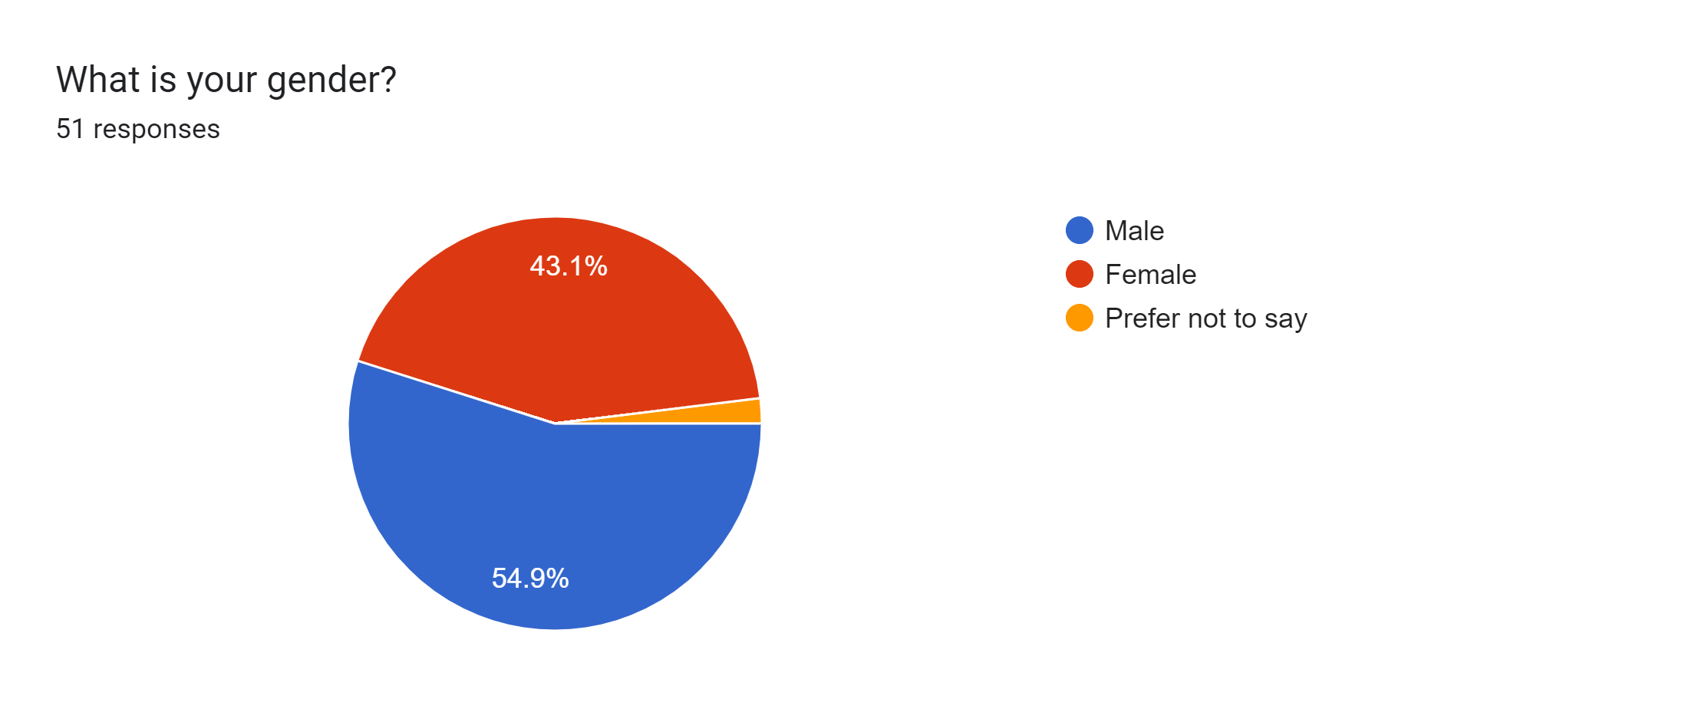
Gender
Male
Female
Prefer not to say
This graph shows thar 54.9% respondents are Male while 43.1%are female and only 2% respondent prefer not to say.

Slide 3
Basic knowledge about ai tools
1. Taught growing up
2. Very basic knowledge
3. No idea
This graph shows that 59% responses are in the very basic knowledge, 35% are yes, I was taught about it growing up, 12% no idea.

Slide 4
Ever used ai tools?
yes
no
This responses shows that 74% are familiar with AI, and 26% are familiar not familiar.

Slide 5
Increase in unemploymwent
This graph shows that 45% are Ai dependent, 25% are people related to this, 25% have no idea, 5% not responses

Slide 6
Mostly used ai tool
chatgpe
Negative
Neutral
This graph shows that BARD 17%, Chatgpt 74%, no idea 10%, Quill Bot 4% uses AI tools

Slide 7
Personally experienced ai tools?
I believe in natural thinking.
Maybe in future.
No its usage in not my cup of tea
Yes its helpful
The 22.2% of respondents
Always use AI in their field of
occupation and 74.1% use it
sometimes while 3.7% never use
It.

Slide 8
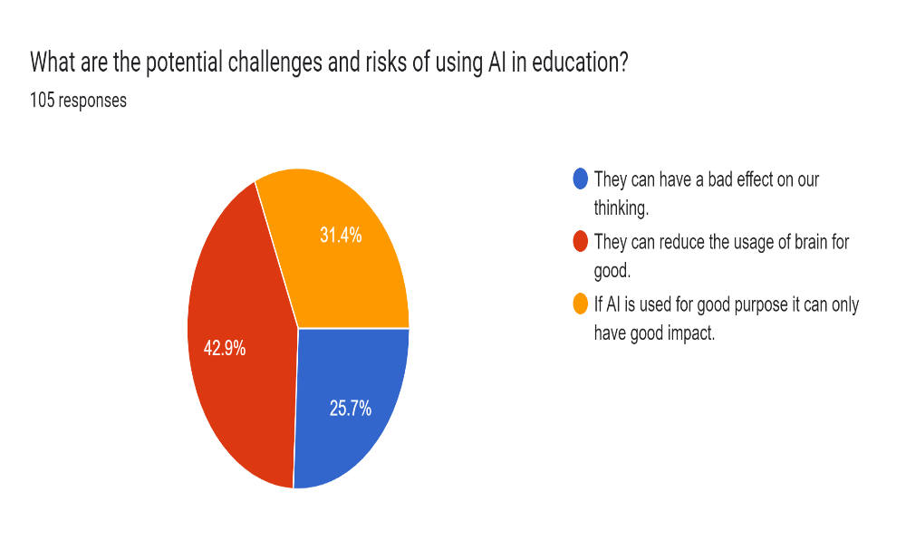
What are the potential challenges and risks of using AI in education?
They can have a bad effect on our thinking.
They can have a bad effect on our thinking.
They can have a bad effect on our thinking.
1. They can have a bad effect on our thinking
2. They can reduce the usage of brain for good.
3. If AI is used for good purpose it can only have good impact.
This graph shows that 42.9% have opinion to damage brain, 31.4% have opinion for good purposes and 26.7% thought it put bad effect

Slide 9
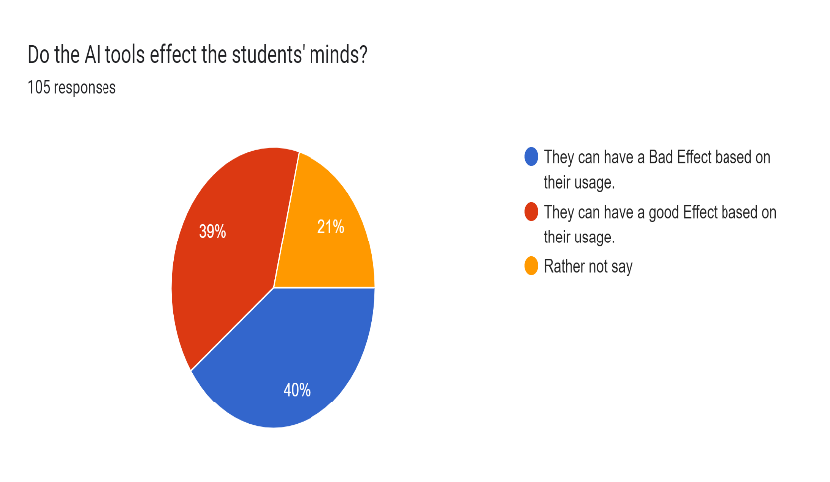
Do the AI tools effect the students' minds?
1. They can have a Bad Effect based on their usage.
2. They can have a good Effect based on their usage.
3. Rather not say.
This graph shows that 39% have good effect, 21% have no opinion and 40% have opinion to bad effect on mind level

Slide 10
Conclusion:
We concluded that the AI tools have good as well as bad effects. Some people consider it destruction while some consider it good in society. So in my opinion I prefer that AI has benefits as well as disadvantages so it is up to us how we can use it? If we use it in a good manner it will help us other we will destroy in few years.

